Slide 1
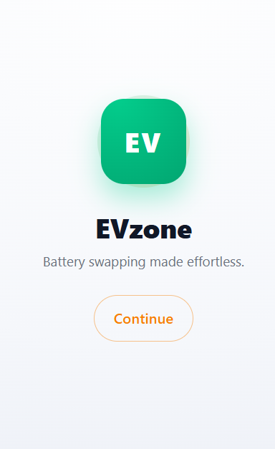
Evz Splash Screen Light (react)

Slide 2
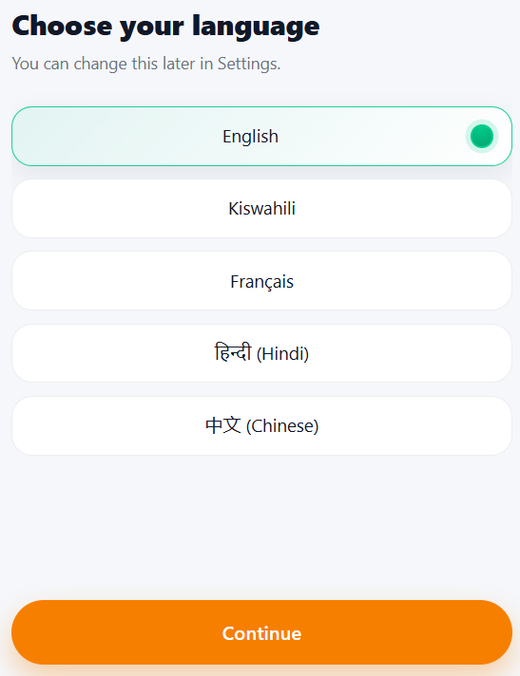
Evz Language Select Screen Light (react)

Slide 3
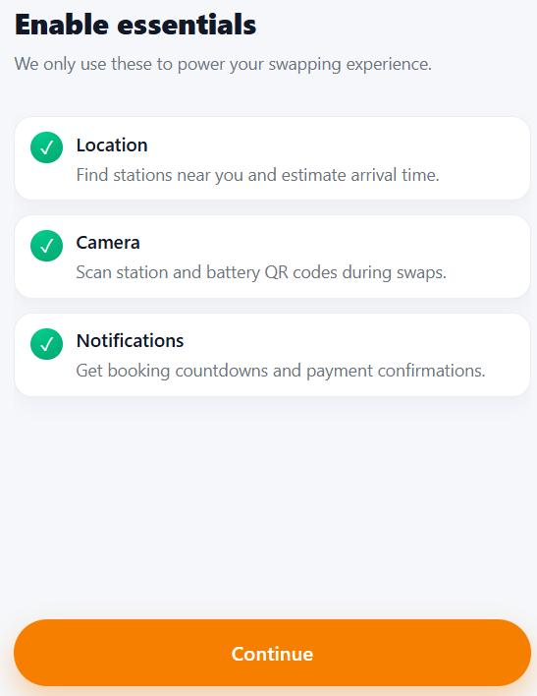
Evz Permission Intro Screen Light (react)

Slide 4
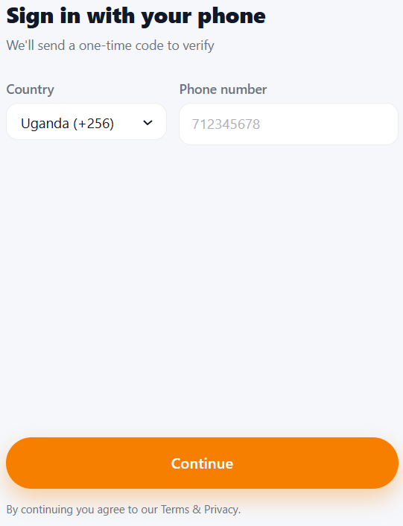
Evz Phone Entry Screen (react Light)

Slide 5
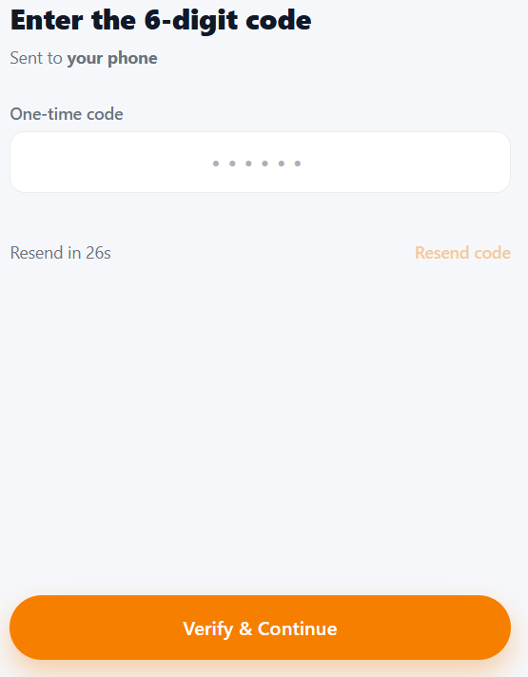
Evz Otp Verify Screen (react Light)

Slide 6
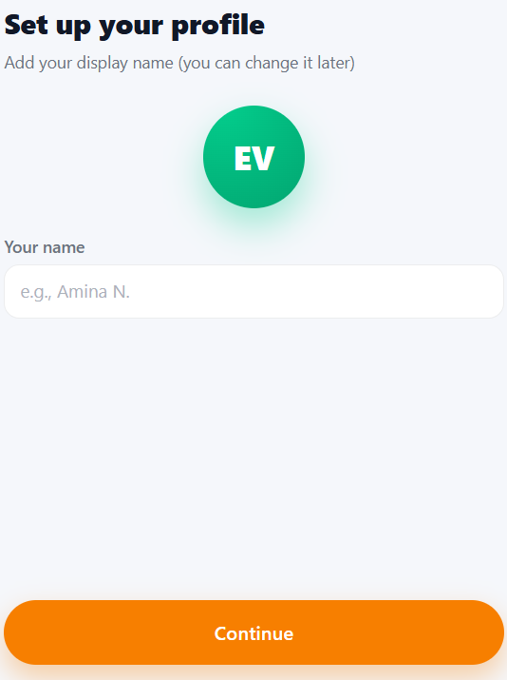
Evz Profile Setup Screen (react Light)

Slide 7
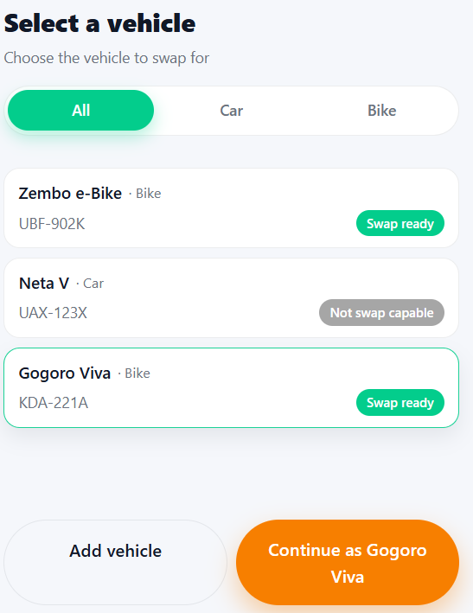
Evz Vehicle Select Screen (react Light)
For Car, Redirect to screen showing No Car swap stations in your area
For Add Vehicle redirect to My Vehicles

Slide 8
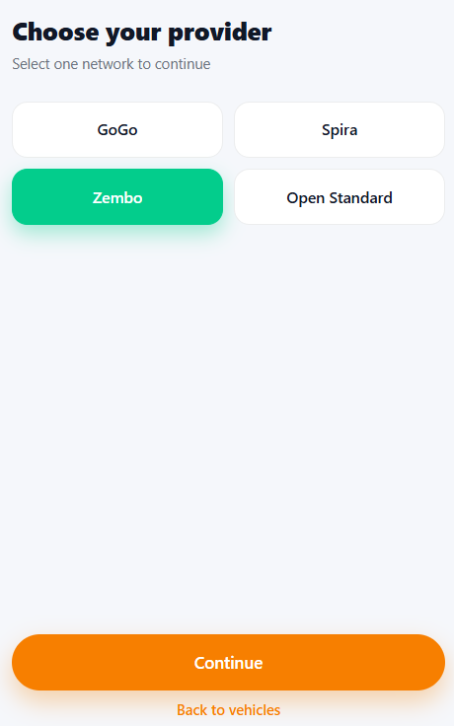
Evz Provider Select Screen (react Light)

Slide 9
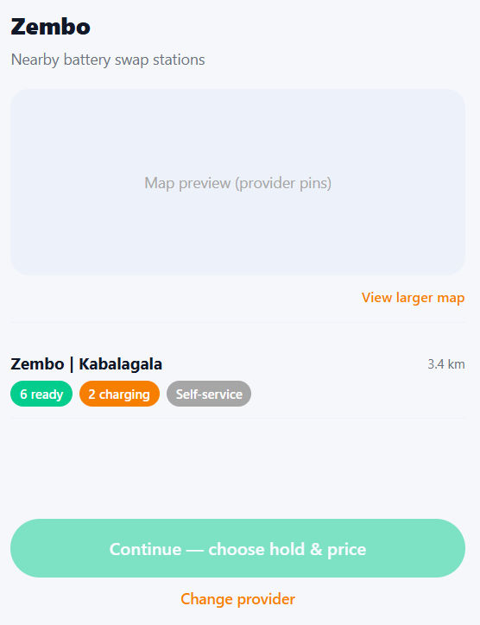
Evz Station Map & List Screen (react Light)

Slide 10
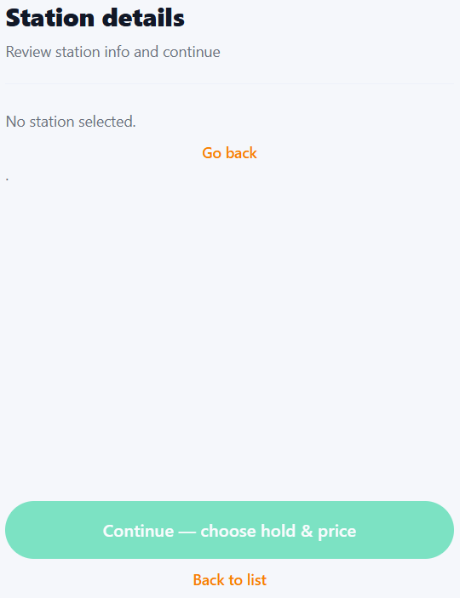
Evz Station Details Sheet Screen (react Light)

Slide 11
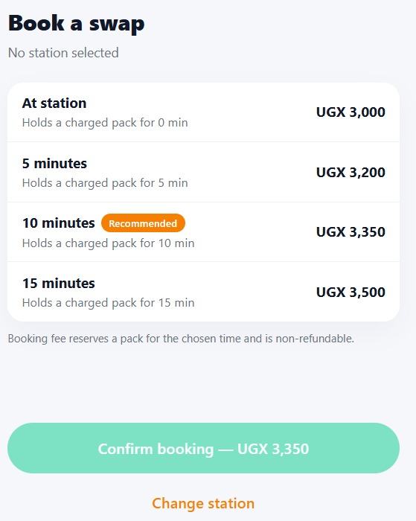
P05-s01 – Hold Select (react Light)

Slide 12
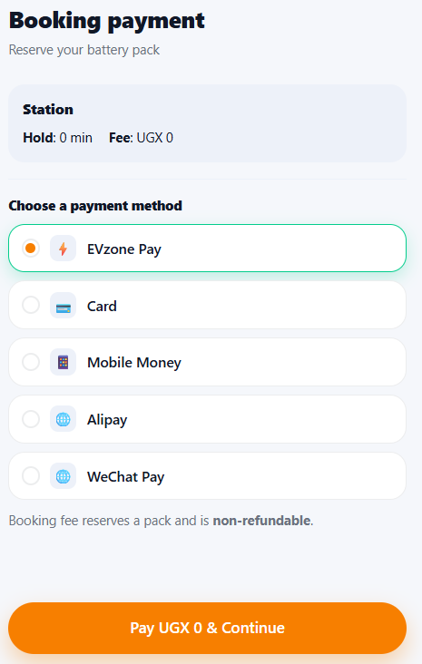
P05-s02 – Booking Payment (react Light)

Slide 13
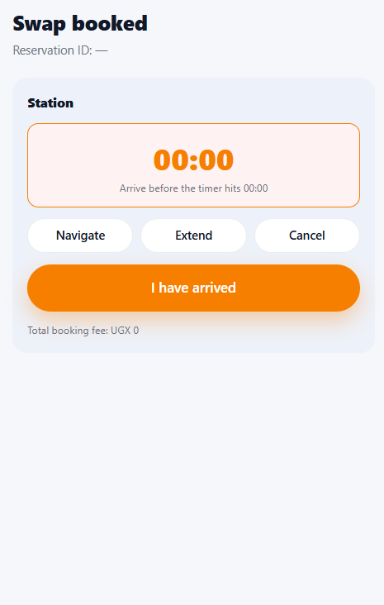
P05-s03 – Booking Confirmed Countdown (react Light)

Slide 14
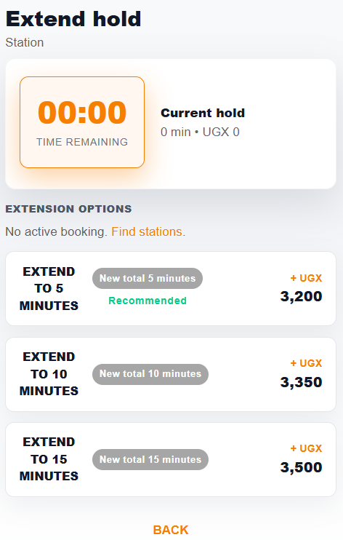
P06-s01 – Extend Hold (evz P 06 S 01 Extend Hold Mobile Clean)

Slide 15
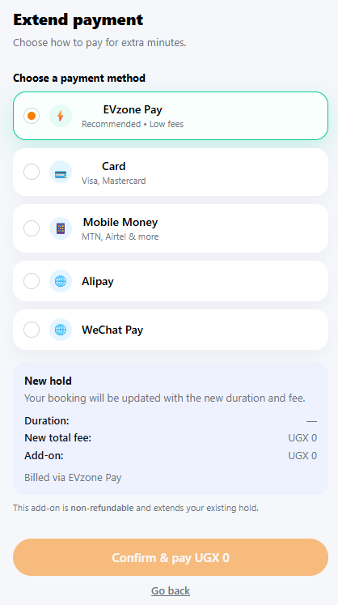
P06-s02 – Extend Payment (react Light)

Slide 16
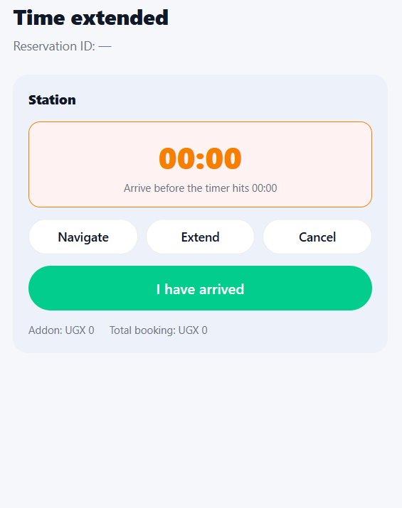
P06-s03 – Time Extended (react Light)

Slide 17
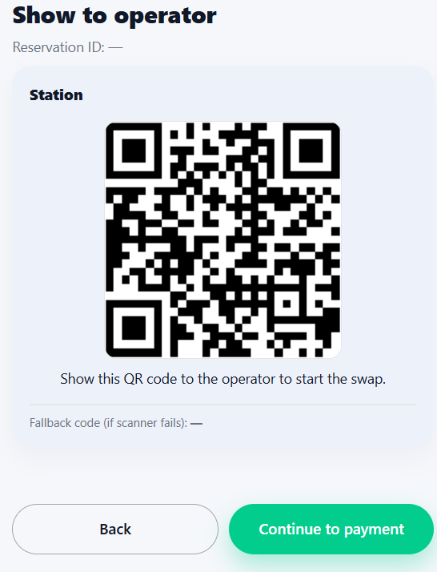
P07-s01 – Arrived Show Qr (react Light)

Slide 18
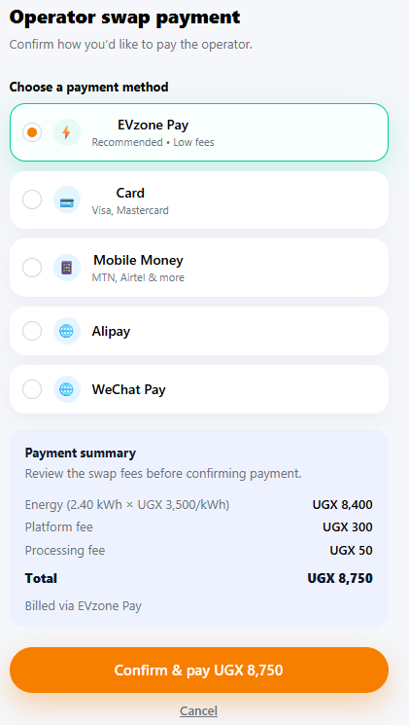
P07-s02 – Operator Swap Payment (react Light)

Slide 19
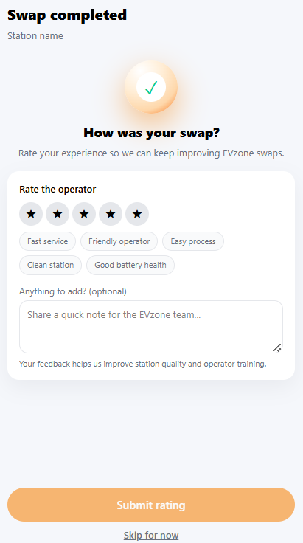
P07-s03 – Swap Completed Rating (react Light)

Slide 20
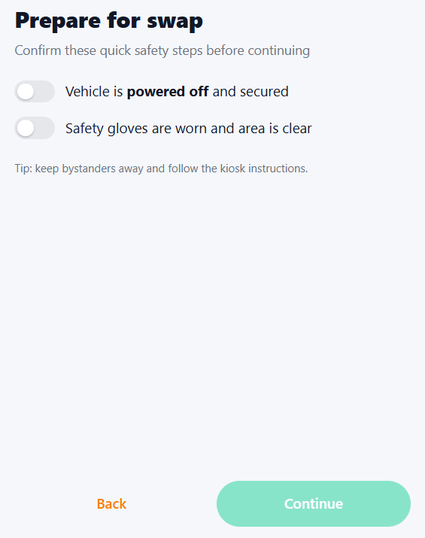
P08-s01 – Safety Checklist (react Light)

Slide 21
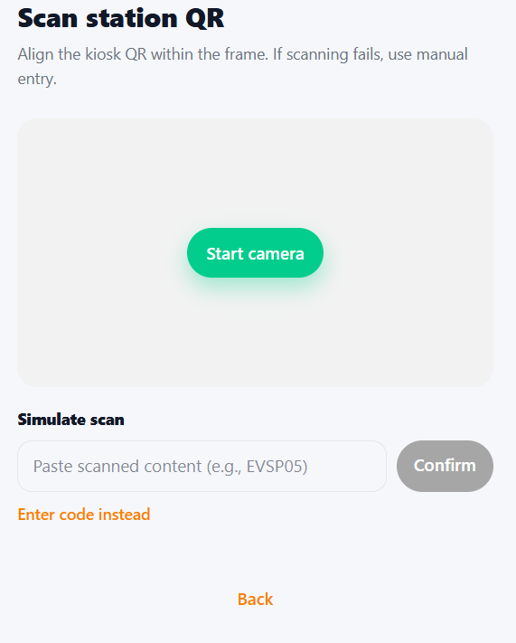
P08-s02 – Station Identify Scan (react Light)

Slide 22
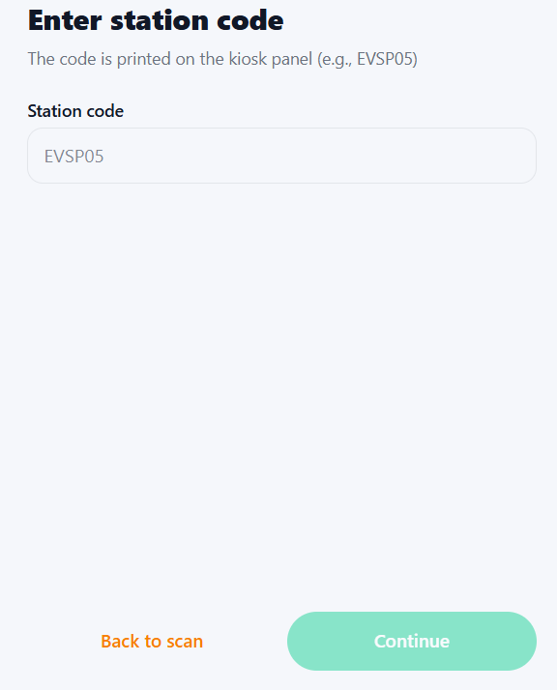
P08-s03 – Station Identify Code (react Light)

Slide 23
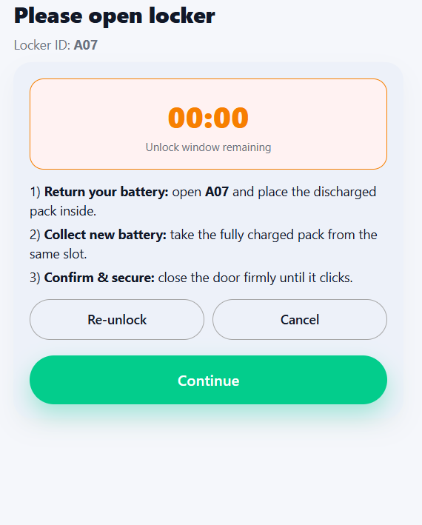
P09-s01 – Locker Assigned Countdown (react Light)

Slide 24
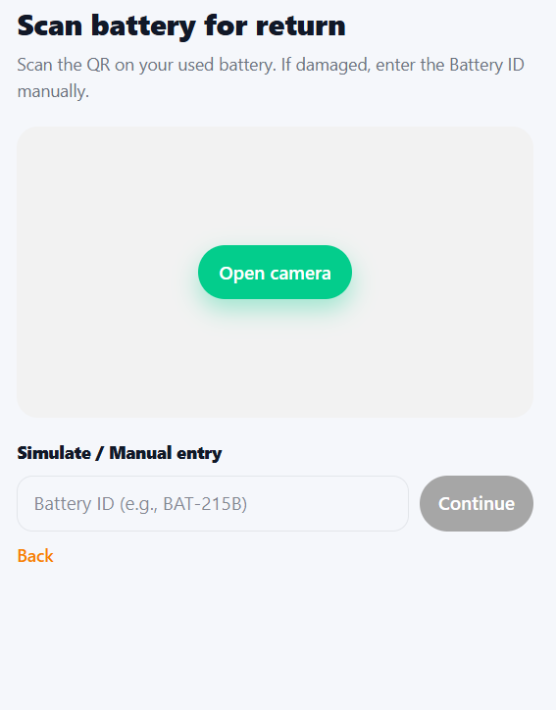
P09-s02 – Scan Return Battery (react Light)

Slide 25
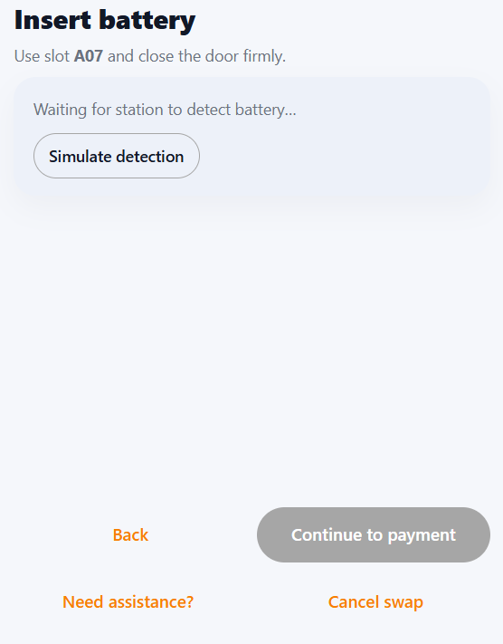
P09-s03 – Insert Return Wait Detect (react Light)

Slide 26
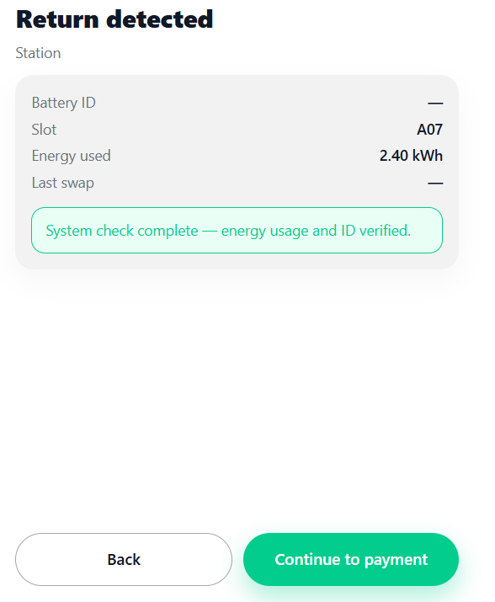
P10-s01 – Return Detected Summary (react Light)

Slide 27
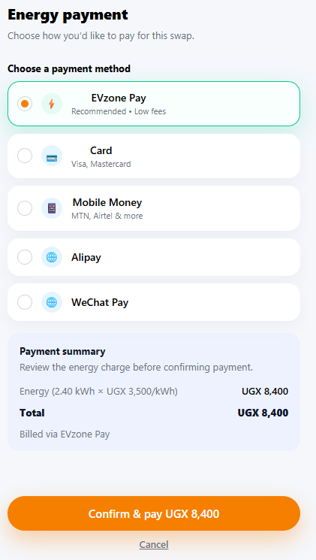
P10-s02 – Energy Payment (react Light)

Slide 28
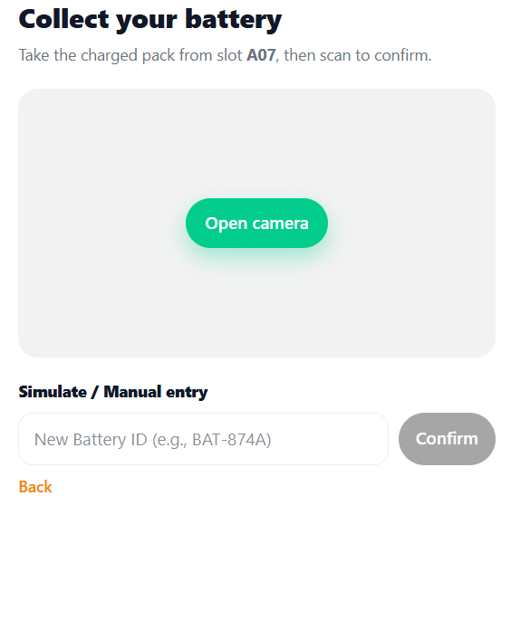
P10-s03 – Collect New Battery (react Light)

Slide 29
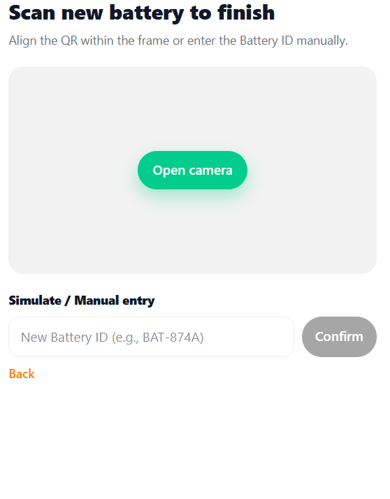
P11-s01 – Scan New Battery (react Light)

Slide 30
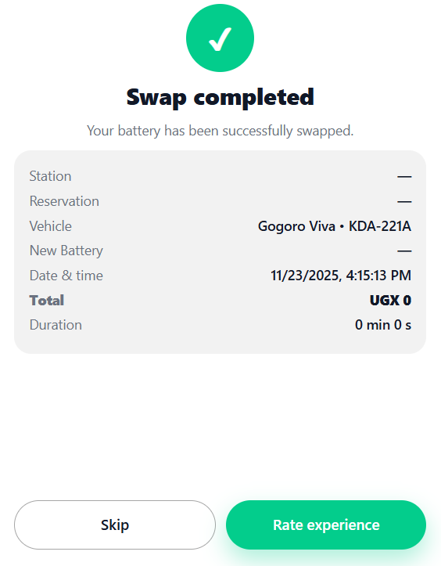
P11-s02 – Swap Completed Summary (react Light)

Slide 31
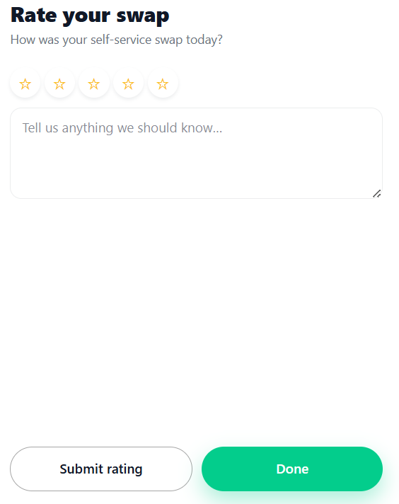
P11-s03 – Rate Experience (react Light)

Slide 32
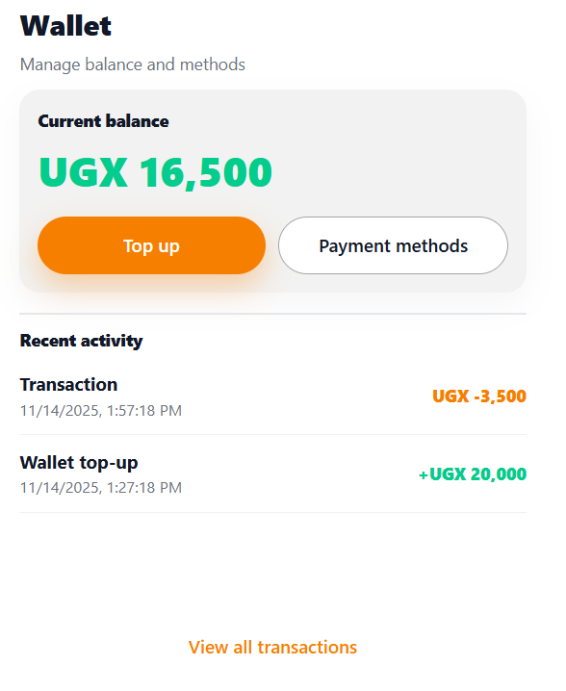
P12-s01 – Wallet Home (react Light)

Slide 33
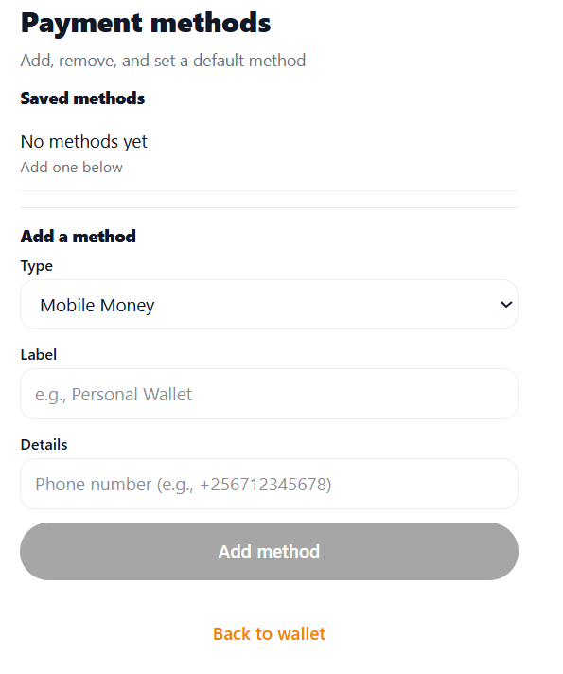
P12-s02 – Payment Methods (react Light)

Slide 34
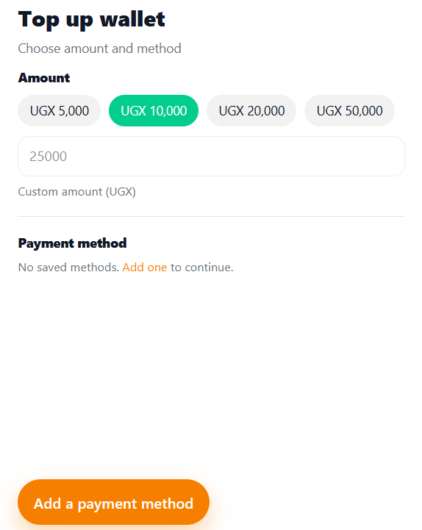
P12-s03 – Top Up (react Light)

Slide 35
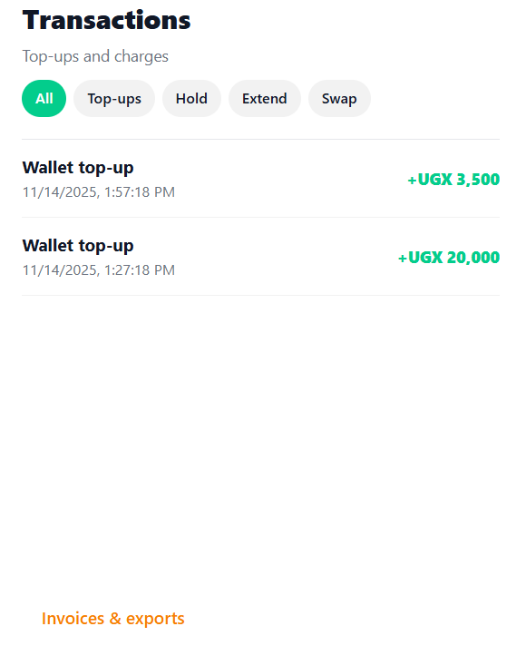
P13-s01 – Transactions List (react Light)

Slide 36
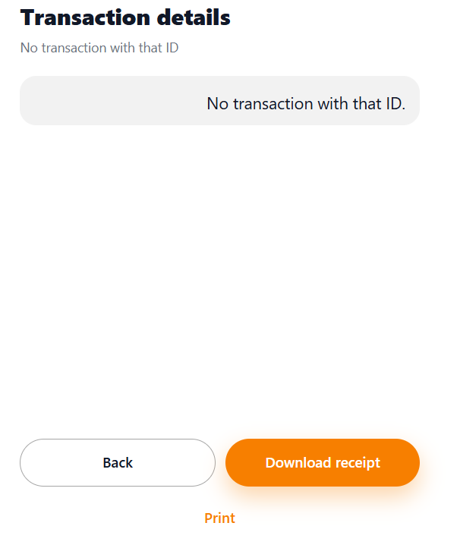
P13-s02 – Transaction Details (react Light)

Slide 37
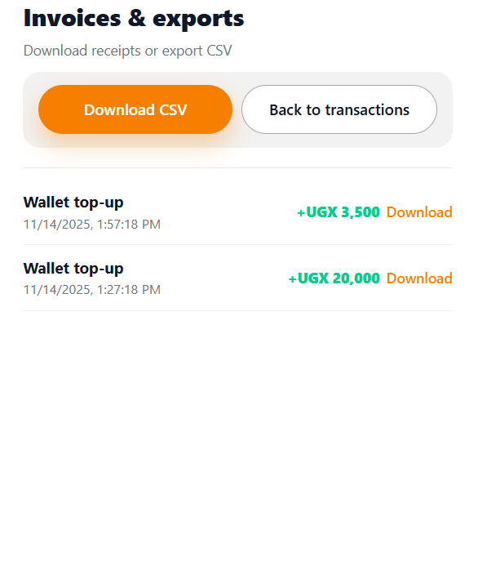
P13-s03 – Invoices (react Light)

Slide 38
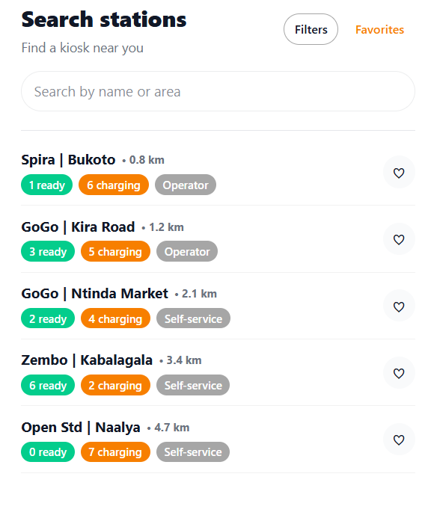
P14-s01 – Search Stations (react Light)

Slide 39
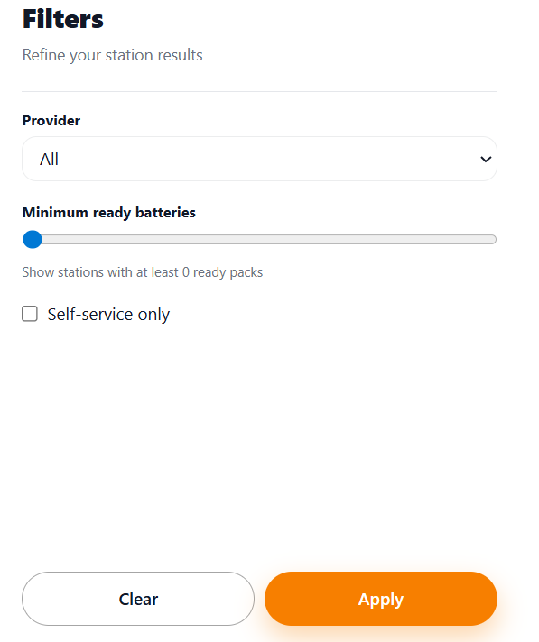
P14-s02 – Filters Sheet (react Light)

Slide 40
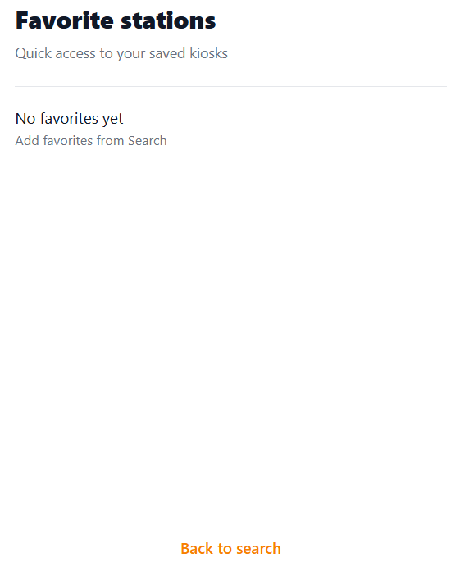
P14-s03 – Favorites Stations (react Light)

Slide 41
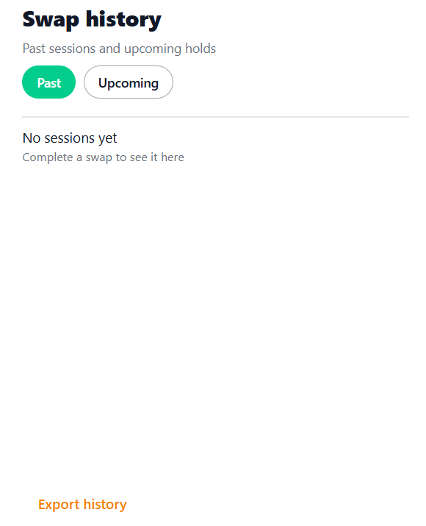
P15-s01 – Swap Sessions (react Light)

Slide 42
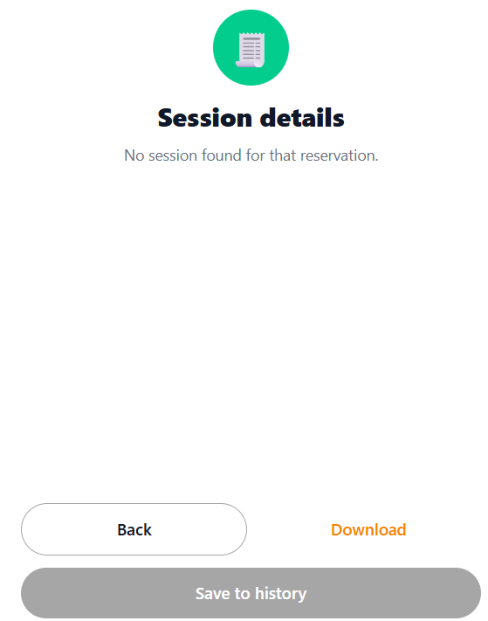
P15-s02 – Swap Session Details (react Light)

Slide 43
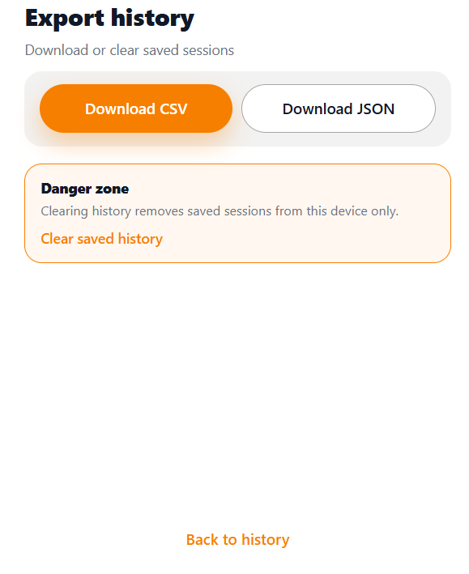
P15-s03 – Export History (react Light)

Slide 44
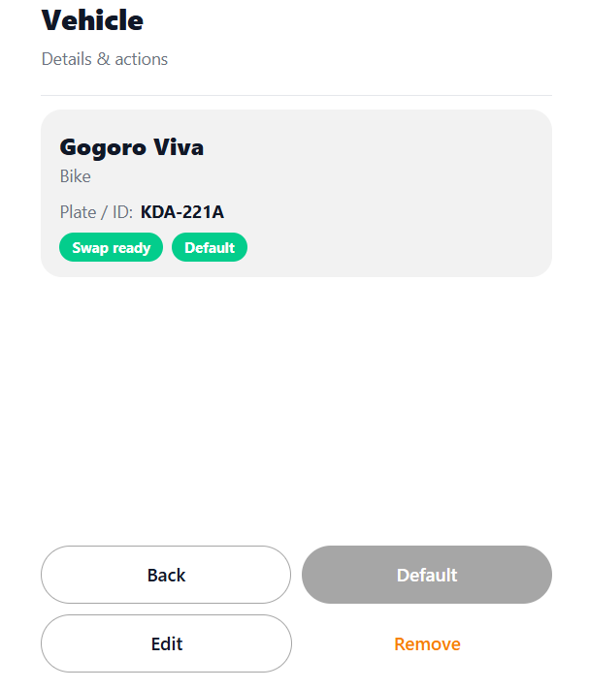
P16-s01 – Vehicle Details (react Light)

Slide 45
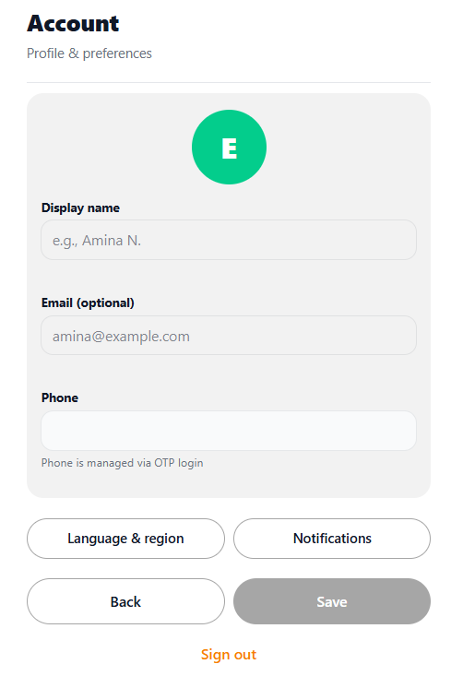
P17-s01 – Profile (react Light)

Slide 46
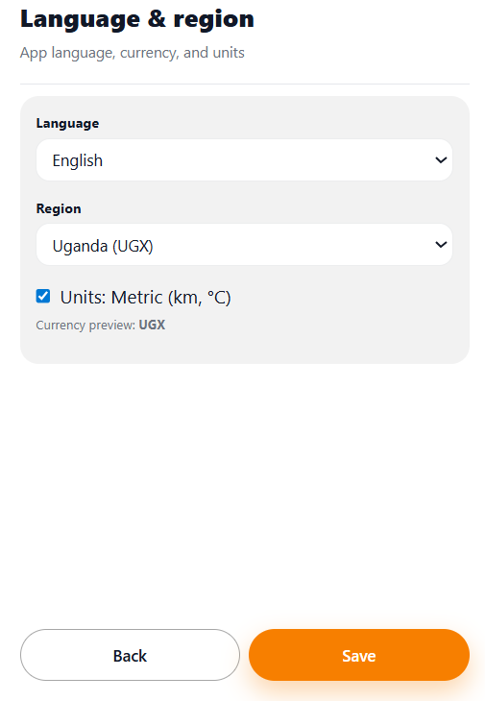
P17-s02 – Language & Region (react Light)

Slide 47
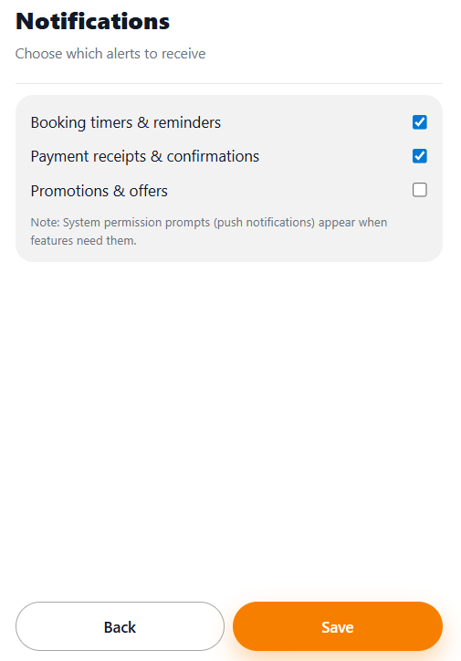
P17-s03 – Notifications Settings (react Light)

Slide 48
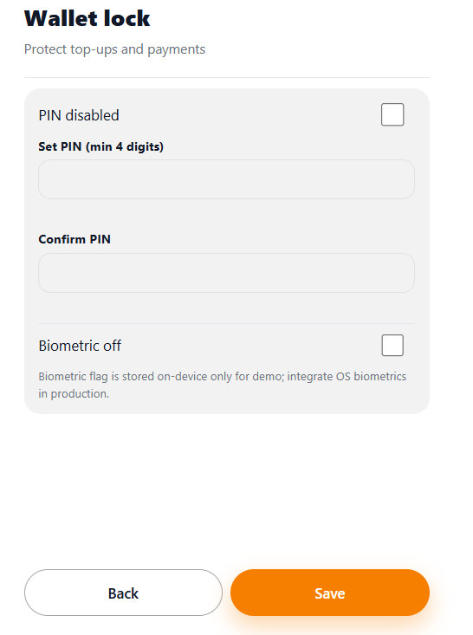
P18-s01 – Lock Wallet (react Light)

Slide 49
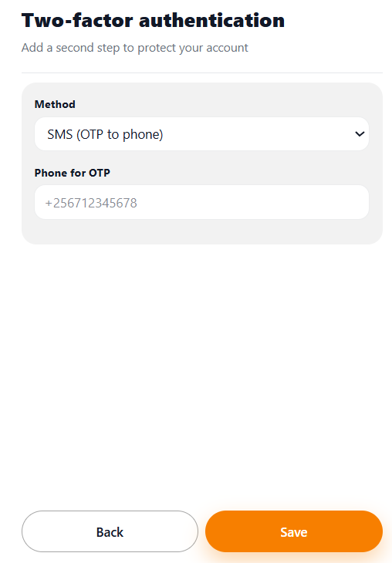
P18-s02 – Two-factor Setup (react Light)

Slide 50
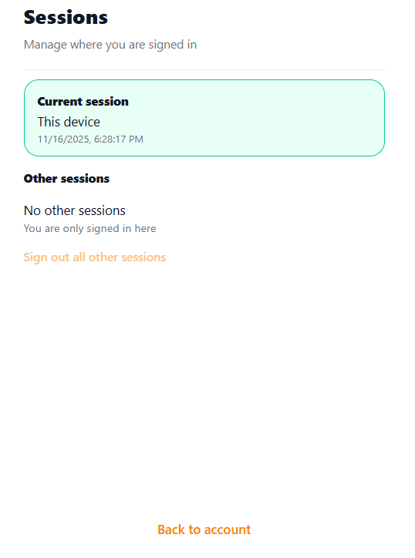
P18-s03 – Session Management (react Light)

Slide 51

P19-s01 – Dashboard Overview (react Light)

Slide 52

P19-s02 – Carbon Savings Detail (react Light)

Slide 53

P19-s03 – Battery Health Detail (react Light)

Slide 54

P20-s01 – Help Center (react Light)

Slide 55

P20-s02 – Contact Support (react Light)

Slide 56

P20-s03 – Report Issue (react Light)

Slide 57

P21-s01 – Booking Expired (react Light)

Slide 58

P21-s02 – Booking Cancel Confirm (react Light)

Slide 59

P21-s03 – No Stations Found (react Light)

Slide 60

P22-s01 – Location Permission (react Light)

Slide 61

P22-s02 – Camera Permission (react Light)

Slide 62

P22-s03 – Notifications Permission (react Light)

Slide 63

P23-s01 – Offline Mode (react Light)

Slide 64

P23-s02 – Network Error (react Light)

Slide 65

P23-s03 – Maintenance (react Light)

Slide 66

P24-s01 – Payment Failed (react Light)

Slide 67

P24-s02 – Payment Pending (react Light)

Slide 68

P24-s03 – Refund Issued (react Light)

Slide 69

P25-s01 – Gps Disabled (react Light)

Slide 70

P25-s02 – Map Provider Unavailable (react Light)

Slide 71

P25-s03 – Location Out Of Bounds (react Light)

Slide 72

P26-s01 – Locker Timeout (react Light)

Slide 73

P26-s02 – Locker Reassign (react Light)

Slide 74

P26-s03 – Escalate To Operator (react Light)

Slide 75

P27-s01 – Invalid Station Qr (react Light)

Slide 76

P27-s02 – Battery Qr Unreadable (react Light)

Slide 77

P27-s03 – Battery Mismatch (react Light)

Slide 78

P28-s01 – Terms & Privacy (react Light)

Slide 79

P28-s02 – Data Consent (react Light)

Slide 80

P28-s03 – Delete Account (react Light)

Slide 81

P29-s01 – Promotions (react Light)

Slide 82

P29-s02 – Referrals (react Light)

Slide 83

P29-s03 – Provider Plans (react Light)

